Slide 1
Extended Task Resubmission
James Salazar 1269132
Mateusz Gren 1025504
Michael Lazarus 1206994

Slide 2




Algorithm
Baseline:
Extension:
1)
3)
1)
3)
2)
2)

Slide 3
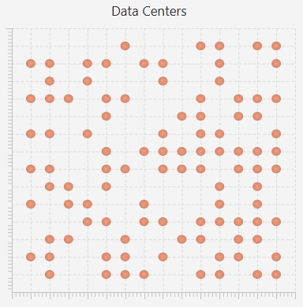
Architecture
Grid
Fixed Size
Datacenter (DC)
Randomly Distributed
Physical Machine (PM)
Fixed Number / DC
CPU, Memory, Bandwith
Virtual Machine (VM)
Shares Memory of a PM
1 Job at a Time
Job
Gaussian Distributed Execution Time

Slide 4
Implementation
Job
Single Thread Using Thread.sleep() as „Operating Time“
Probability of Failing Determined by Job & VM
Migrations
Minimize Latency
Checking for „Free“ PM in Same DC
Choosing Next DC by Comparing Bandwith
Increasing Failure Rate
After Every Job to a Given Limit
Reset to „0“ After Reboot

Slide 5
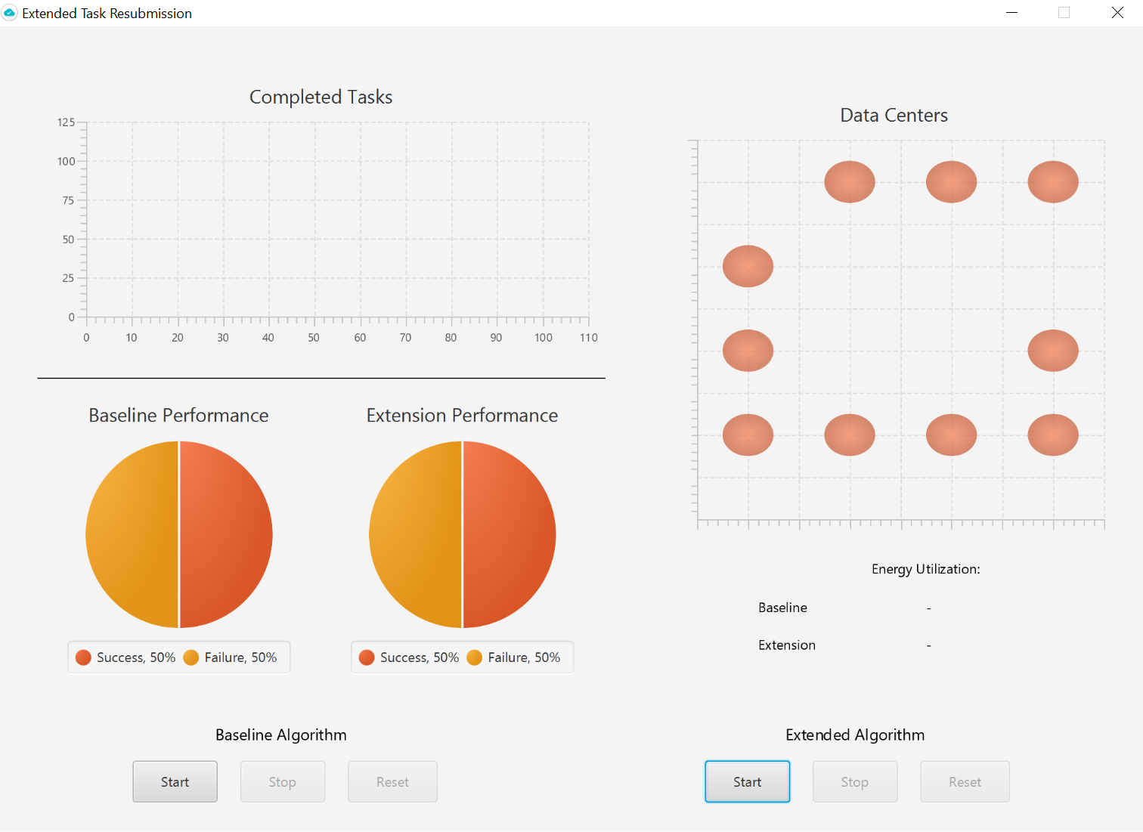

Framework
Implementation
Java 1.8
Visualization
JavaFX 8

Slide 6
SLAs
Maximize Number of Completed Jobs
The Success-Rate of Distributed Jobs Must be Higher Than 80%
Minimize Latency
A Job is Always Transferred to the Next Best PM
The Average Latency Must be Lower Than 500 ms
Keep Energy Utilization in Suitable Area
Energy Consumption of the Extended Implementation Must Not Be Twice as High Compared to the Baseline

Slide 7
Live Demo!
James Salazar 1269132
Mateusz Gren 1025504
Michael Lazarus 1206994

